Slide 1
Event-Driven Architecture
System Design Fundamentals - Architectural Patterns

Slide 2
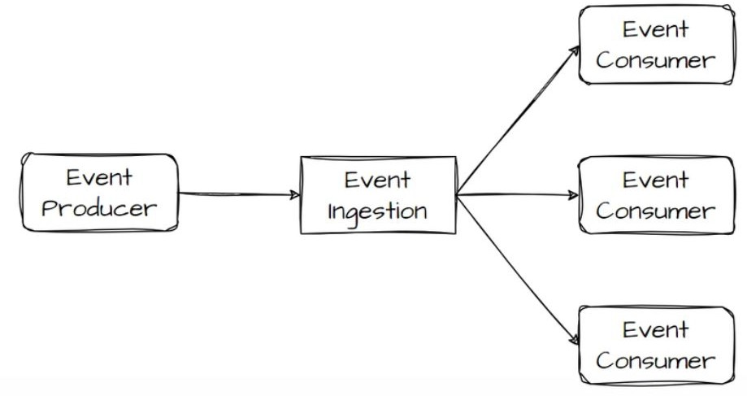
Introduction to Event-Driven Architecture
Deﬁnition: A system design where components communicate through events rather than direct calls.
Key Characteristics:
  Asynchronous processing
  Loose coupling
  Scalability & ﬂexibility
Why Use It?
  Enhances system responsiveness
  Enables real-time event processing
  Supports complex workﬂows

Slide 3
Synchronous vs. Asynchronous Systems
Synchronous Communication (Request-Response Model)
  Blocking calls
  Tight coupling
  Example: Traditional HTTP APIs
Asynchronous Communication (Event-Driven Model)
  Non-blocking
  Decoupled components
  Example: Message queues & event brokers

Slide 4
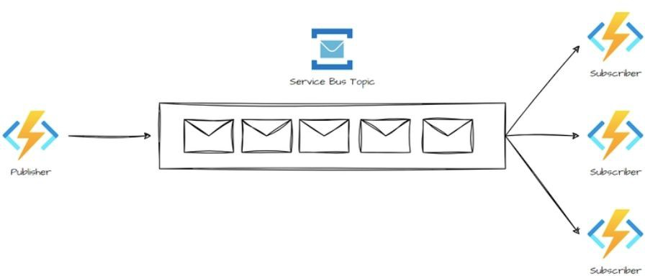
Pub-Sub vs. Event Streaming
Publish-Subscribe Model (Pub-Sub)
  Events are broadcasted to multiple subscribers
  Each subscriber gets the event once
  Example: RabbitMQ, AWS SNS
Event Streaming
  Events are stored & consumed in order
  Consumers process events at diﬀerent times
  Example: Kafka, AWS Kinesis

Slide 5
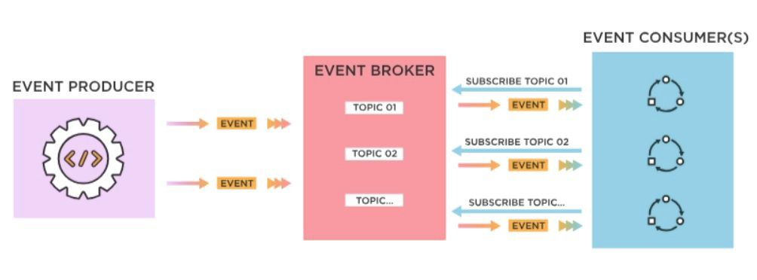
Key Components of an Event-Driven System
Event Producers (Generate events)
Event Brokers (Transmit & store events) - Examples: Kafka, RabbitMQ, AWS EventBridge
Event Consumers (React to events)
Event Storage (Log-based persistence for replaying events)

Slide 6
Challenges in Event-Driven Architecture
Eventual Consistency (No immediate data synchronization)
Ordering Guarantees (Ensuring events are processed in sequence)
Fault Tolerance & Retries (Handling failures gracefully)
Debugging Complexity (Tracing events across microservices)

Slide 7
Best Practices
Use idempotent event processing to avoid duplicates
Implement dead-letter queues for failed messages
Choose the right event broker based on system needs
Ensure event versioning to handle schema changes

Slide 8
Use Cases of Event-Driven Architecture
Logging & Auditing (Track changes over time)
Real-Time Notiﬁcations (Chat apps, stock price updates)
Microservices Decoupling (Independent scalability & fault tolerance)
IoT Systems (Sensor data processing)
E-commerce Order Processing (Order placed → Payment processed →
Inventory updated)

Slide 9
Important Interview Questions on Event-Driven Architecture
Fundamentals
  What is Event-Driven Architecture (EDA), and how does it diﬀer from traditional request-response architectures?
  Explain the diﬀerence between Pub-Sub and Event Streaming models.
  What are the key components of an event-driven system?
Scalability & Fault Tolerance
  What are some challenges of Event-Driven Architecture, and how do you handle eventual consistency?
  How can you ensure event ordering in distributed event processing?
  What are dead-letter queues (DLQs), and why are they important?
Implementation & Technologies
  What are the diﬀerences between Kafka, RabbitMQ, and AWS EventBridge?
  How do you make event processing idempotent to avoid duplicate execution?
Use Cases & Real-World Applications
  Can you give a real-world example where Event-Driven Architecture is a better choice than a traditional architecture?
  What strategies can you use to handle schema evolution in an event-driven system?

Slide 10
Summary and Key takeaways
Event-driven architecture is key to building scalable, real-time, and decoupled systems.
Choosing between Pub-Sub vs. Event Streaming depends on system needs.
Architectural patterns like CQRS & Event Sourcing enhance ﬂexibility.
Challenges exist but can be mitigated with best practices.
What’s next:
  Summary - Architecture patterns

Slide 11
Section Summary - Architectural Patterns
Architectural Patterns in System Design
  Explored diﬀerent architectural patterns and their trade-oﬀs.
  Multi-Tier Architecture: Layered approach for scalability and separation of concerns.
  Microservices: Decoupled services enabling independent scaling & deployment.
  Event-Driven Architecture: Asynchronous, scalable, and loosely coupled systems.
  Learned real-world use cases, performance considerations, and best practices for choosing the right architecture.
What’s Next:
  Web Concepts in System Design

